Slide 1
Heterogeneous Programming with OpenMP

Slide 2
Heterogenous Computing in HPC

Slide 3
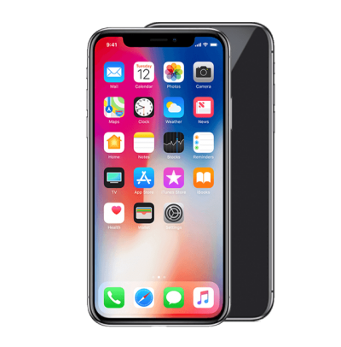
Heterogenous Computing in Mobile Processing

Slide 4
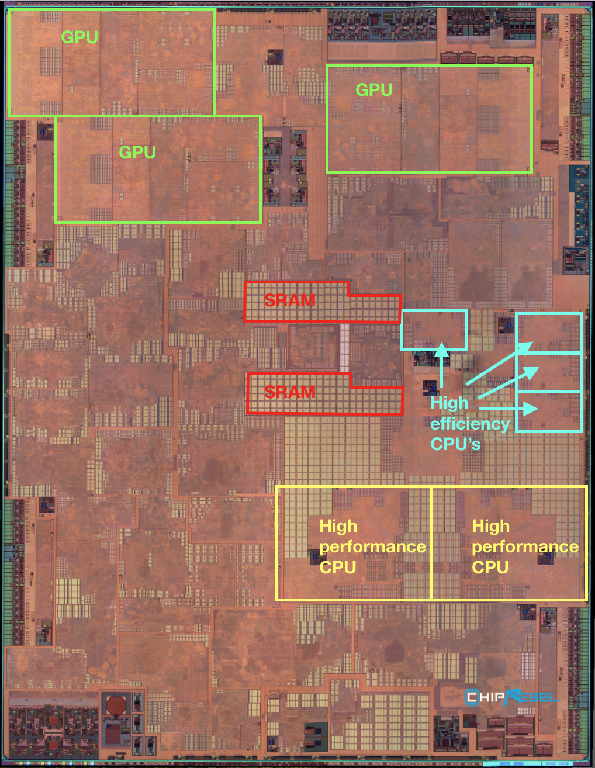
Heterogenous Computing in Mobile Processing
Notes:
Why do we want to have different kinds of processors on a phone?
What is your typical usage? What apps do you have running on your phone?
Can someone share the apps they currently have running (in the background)?
Introduce the notion of a workload.
A bunch of apps with different characteristics and different demands for resources.

Slide 5
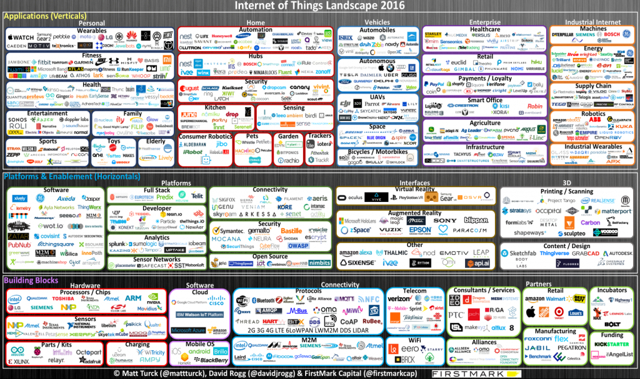
Heterogeneity on the Edge

Slide 6
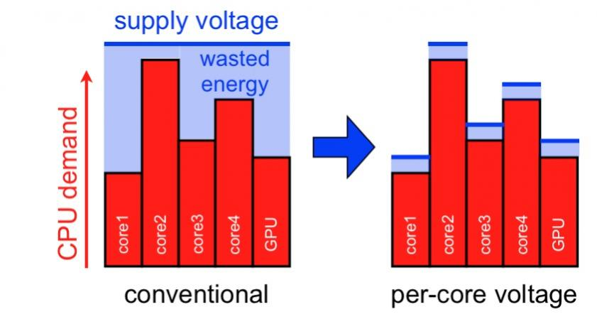
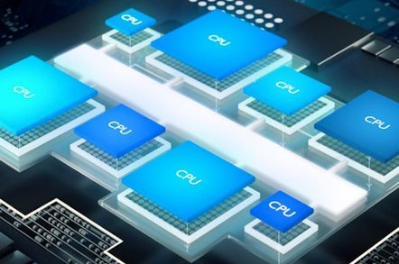
“Soft” Heterogeneity
Fat and Thin Cores
DVFS
image: SemiWiki

Slide 7
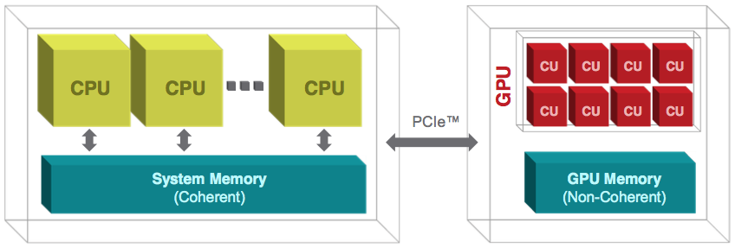
CPU + GPU Heterogeneity
Focus of this module

Slide 8
OpenMP (stands for: Open Multi-Processing )
An Application Program Interface (API) that may be used to explicitly direct multi-threaded, shared-memory parallelism.
Comprised of three primary API components:
Compiler Directives (pragmas)
Runtime Library
Environment Variables
Not an independent language
An extension to Fortran, C, C++

Slide 9









Standardization
Provide a common standard among a variety of shared memory architectures/platforms
Jointly defined and endorsed by a group of major computer hardware and software vendors

Slide 10
OpenMP Features: Programmability
Provide capability to incrementally parallelize a serial program, unlike message-passing libraries which typically require an all-or-nothing approach
Provide the capability to implement both coarse-grain and fine-grain parallelism

Slide 11
OpenMP Features: Low overhead
Establish a simple and limited set of directives for programming shared-memory machines
Significant parallelism can be implemented by using just 3/4 directives

Slide 12
OpenMP Features: Portability
The API is specified for C/C++ and Fortran
Most major platforms have been implemented including Unix/Linux platforms and Windows

Slide 13
OpenMP Features
Loop centric
Focus on data parallelization
Assumes programmers know what they are doing
Code regions marked parallel are assumed independent
compiler might still choose not to parallelize
Programmer is responsible for protection against race conditions

Slide 14
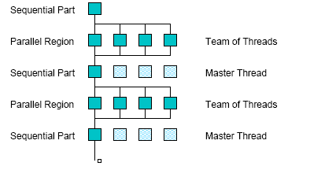
OpenMP Execution Model
aka fork-join model

Slide 15
Demo: Hello World in OpenMP

Slide 16
Hello World Demo: Recap
Insert parallel directive in source
All directives begin with #pragma
OpenMP doesn’t check if it is legal to parallelize
#pragma omp parallel
{
// code to execute in parallel
}
#pragma omp parallel for
for (int i = 0; i < N; i++) {
}

Slide 17
Hello World Demo: Recap
parallel for pragma syntax
#pragma omp parallel for [ clause [ clause ] ... ] new-line
for-loop
clause can be one of the following:
shared (list)
private( list)
reduction( operator: list)
schedule( type [ , chunk ] )
nowait (C/C++: on #pragma omp for)
demo

Slide 18
Hello World Demo: Recap
Place pragma just before loop
Compiler calculates the number of iterations each thread will execute
Compiler also manages data partitioning
Synchronization is implicit

Slide 19
Limitations and Semantics
Not all loops can be parallelized
#pragma omp parallel for
for (i=0; i < N; i++) {
a[i] = b[i] + a[i – 1];
}
Loops amenable to parallelization
No loop-carried dependence
Loop index: signed integer
Termination Test: <,<=,>,=> with loop invariant int
Incr/Decr by loop invariant int; change each iteration
Count up for <,<=; count down for >,>=
Basic block body: no control in/out except at top

Slide 20
Data Sharing
Data and variables can be shared or private
Shared data, visible to all threads, similarly named
Private data, visible to a single thread (often stack-allocated)
Use shared and private clauses with pragma
Default is shared
Loop index is private

Slide 21
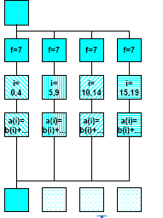
Privatization
#pragma omp parallel private(f)
{
f=7;
#pragma omp for
for (i=0; i<20; i++)
a[i] = b[i] + f * (i+1);
} /* omp end parallel */

Slide 22
GPU Computing
Programming tools
CUDA for NVIDIA GPUs
OpenCL for AMD GPUS

Slide 23
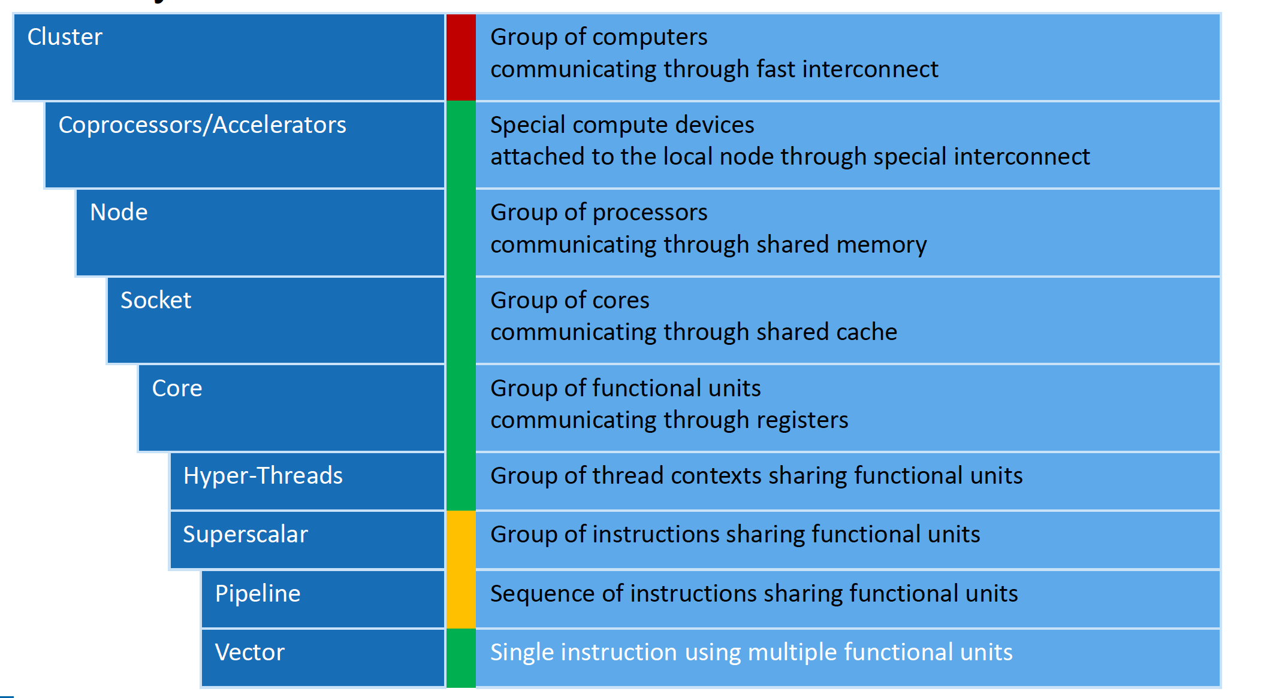
GPU Programming with OpenMP
OpenMP supports parallelism at several levels

Slide 24
GPU Programming with OpenMP
Support for GPU task offloading was added, starting with OpenMP 4.5
GCC and LLVM both provide OpenMP implementations that support GPU task offloading
Offloading is achieved via three main pragmas and several supporting clauses
target
teams
distribute

Slide 25
The target directive
Offload execution of immediately following code block to the GPU
Data in the code block is copied onto the target device
The target device owns the data; by default the CPU cannot access the data during kernel execution
float*a, *b, *c;
a = (float*) malloc(sizeof(float) * M);
b = (float*) malloc(sizeof(float) * M);
c = (float*) malloc(sizeof(float) * M);
#pragma omp target
for (i = 0; i < M; i++)
c[i] = a[i] * b[i];
}

Slide 26
The teams directive
The teams directive creates groups of threads
Allows for better utilization of the massive parallelism available on the GPU
All teams have the same number of threads
There is no synchronization between team execution
The notion of teams is similar to threads blocks in CUDA and workgroups in OpenCL
float*a, *b, *c;
a = (float*) malloc(sizeof(float) * M);
b = (float*) malloc(sizeof(float) * M);
c = (float*) malloc(sizeof(float) * M);
#pragma omp target teams
for (i = 0; i < M; i++)
c[i] = a[i] * b[i];
}

Slide 27
The distribute directive
Distribute the work across teams
Distribution is done statically (i.e., fixed assignment)
No guarantee that all teams will execute simultaneously (or sequentially)
float*a, *b, *c;
a = (float*) malloc(sizeof(float) * M);
b = (float*) malloc(sizeof(float) * M);
c = (float*) malloc(sizeof(float) * M);
#pragma omp target teams distribute
for (i = 0; i < M; i++)
c[i] = a[i] * b[i];
}

Slide 28
Demo: GPU offloading with OpenMP

Slide 29
References
image source
Matt Rogg, Firstmark Capital (Edge Computing Platforms)
Michael Klem, Intel (OpenMP levels of parallelism)

